Slide 1
3주차 논문리뷰 Why should I trust you - Explaining the predictions of any classifier

Slide 2
Introduction
Why this paper?
Explainable AI method
LIME : Local Interpretable Model-agnostic Explanation
SP-LIME : Submodular Pick for LIME
Published in 2016, 6265 citation (2016 KDD)
Why?
baseline for XAI
Model-agnostic method

Slide 3
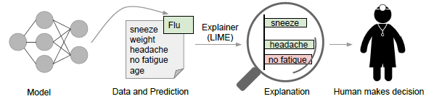
Problem definition
Goal
Explain the prediction of complex model using simple model
Two concepts
Trusting a prediction
Trusting a model

Slide 4
Problem definition
Desired characteristics for Explainers
Interpretable
qualitative understanding between input and response
readily presented to user with visual or textual artifacts
Local fidelity
explanation to be meaningful at least be locally faithful
Model-agnostic
should be able to explain any model
treat original model as a black box
Global perspective

Slide 5
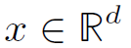
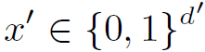
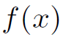
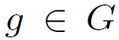
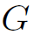
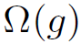
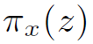
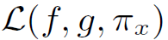
LIME
Local Interpretable Model-agnostic Explanations
Notations
Original representation
Interpretable representation
Original model
Explanation as a model
Set of interpretable models
Measure of complexity
Proximity measure between x and z
Measure how unfaithful g

Slide 6
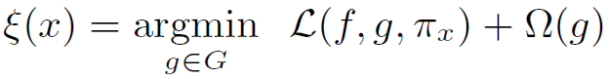
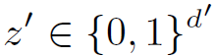
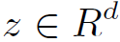
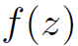
LIME
Local Interpretable Model-agnostic Explanations
Explanation (total objective function)
Sampling for local explanation
Using perturbed sample to learn local behavior
Perturbed sample
Recovered sample in original representation
Labels for explanation model

Slide 7
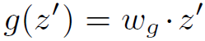
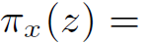
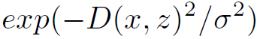
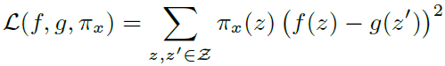
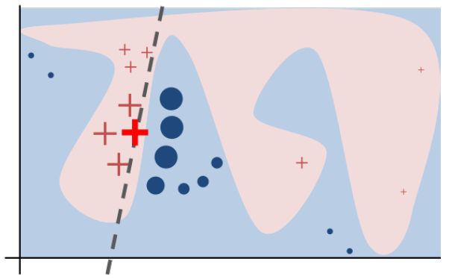
LIME
Local Interpretable Model-agnostic Explanations
Sparse linear explanations
Linear model
Weight by exponential kernel
Local objective function
Explanation
Text : bag of words
image : super-pixels

Slide 8

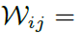
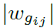
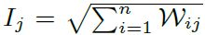
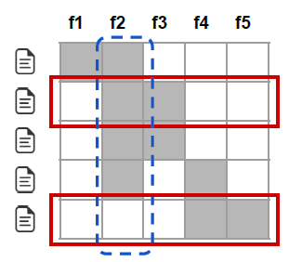
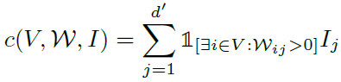
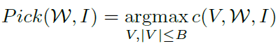
SP-LIME
Submodular Pick LIME
Pick some instances from large budget (explanations)
Explanation matrix
rows component : instances (each explanation)
column component : feature (subpixel of word)
column vector : global importance of component

Slide 9
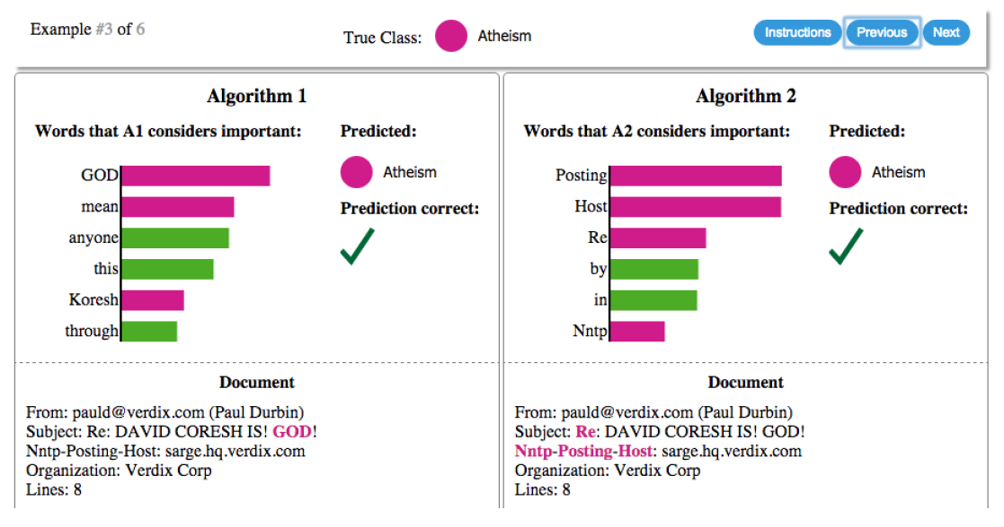
Results
Text classification with SVMs

Slide 10
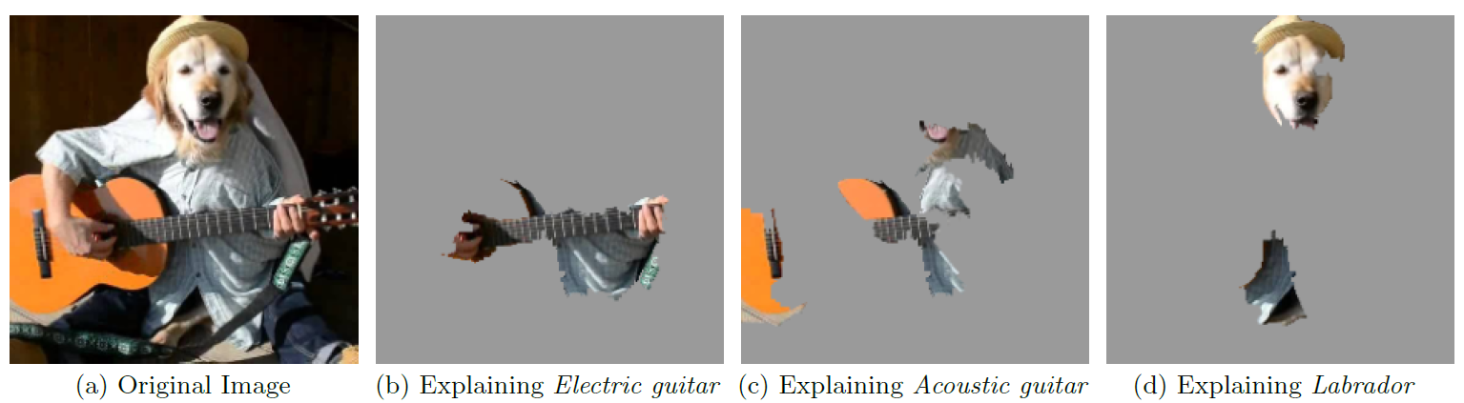
Results
Deep networks for image

Slide 11
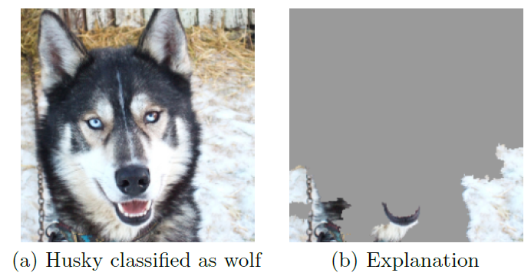
Results
Deep networks for image

Slide 12
END

